Slide 1


BSc Hons Computer Game Design and Development GDV4000 Introduction to Games Industry Practice
Concept and ‘The Pitch’

Slide 2


The Plan
Introduction to the Development Process
Game Concept and the Pitch Document

Slide 3
Introduction to the Development Process
This is a typical overview of the process. Some factors can depend on the ambitions of the game, and milestones set by publishers…
Pre-Release
Initial idea / concept
Design
Development
Funding secured
The Pitch
Development
(“Release To Manufacture”)
RTM /
Gold Master

Slide 4
Introduction to the Development Process
But each stage can be more involved…
Initial idea / concept
Design
Pre-Release
Review
Prototype
Funding secured
Development/ Prototyping
(“Release To Manufacture”)
RTM /
Gold Master
The Pitch
Testing
Milestone
Crunch
Review / Design Eval
Pending deadline

Slide 5

Game Concept and the Pitch Document
The outline of the game concept.
Created by the developer in-house
This can be an outline of the game – The setting, how it’s played, the challenges, goals (both internal and external goals – what needs to be done, and how you want the player to feel), and the Unique Selling Points (USPs).
Make use of diagrams, or illustrations to highlight key elements of the UI, player input, how elements can behave…
If the developer proceeds with the project (which can occur after initial development of a prototype to test the concept), the concept documentation underpins the pitch document.

Slide 6
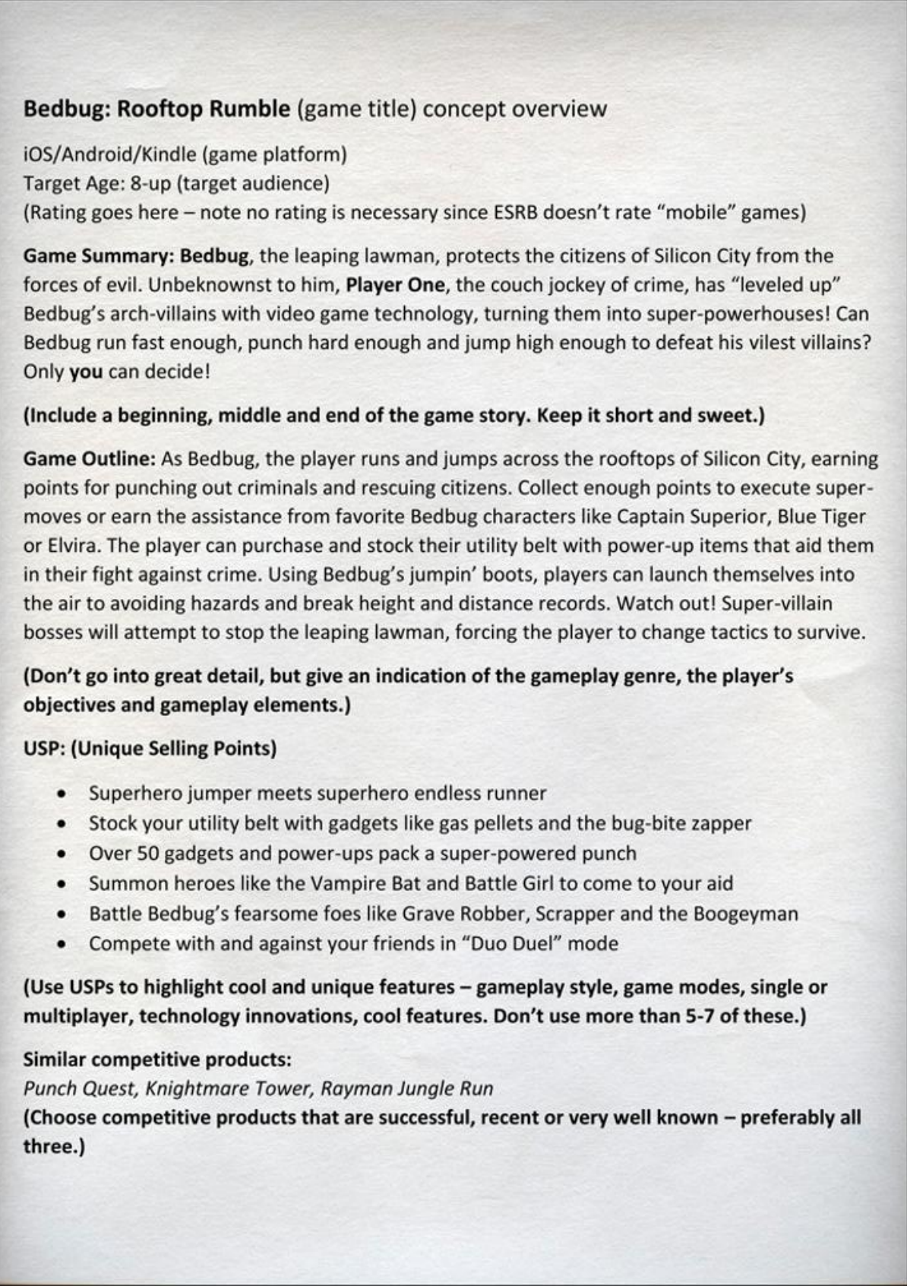
Level Up!
Scott Rodgers produced a version of a one-page concept document in his book ‘Level Up!’.
Platform(s)
Audience
Certification
Project Title
Summary of Game
Outline of Gameplay
USPs – What is going to sell our game?
What else is on the market?

Slide 7
Game Concept and the Pitch Document
The pitch document is typically intended to present the concept to the publisher in order to secure funding to develop the game.
The Pitch is the first time you’ll be presenting your game idea (formally) outside your dev team.
Your concept documentation may be more informal in tone, establishing the core ideas and direction of the game. But the pitch document typically has a more formal layout and structure:
Story Overview – A summary of the background to the game’s setting/ World
Game Overview – What is the game about? The genre, context…
Target Audience – Who is this for?
Look and Feel of the game
A Sample of the Core / Non-Core Mechanics that make the game stand out
Brief overview of the market (justification for choice of genre), and USPs – Why this game? What will make people want to buy it?

Slide 8
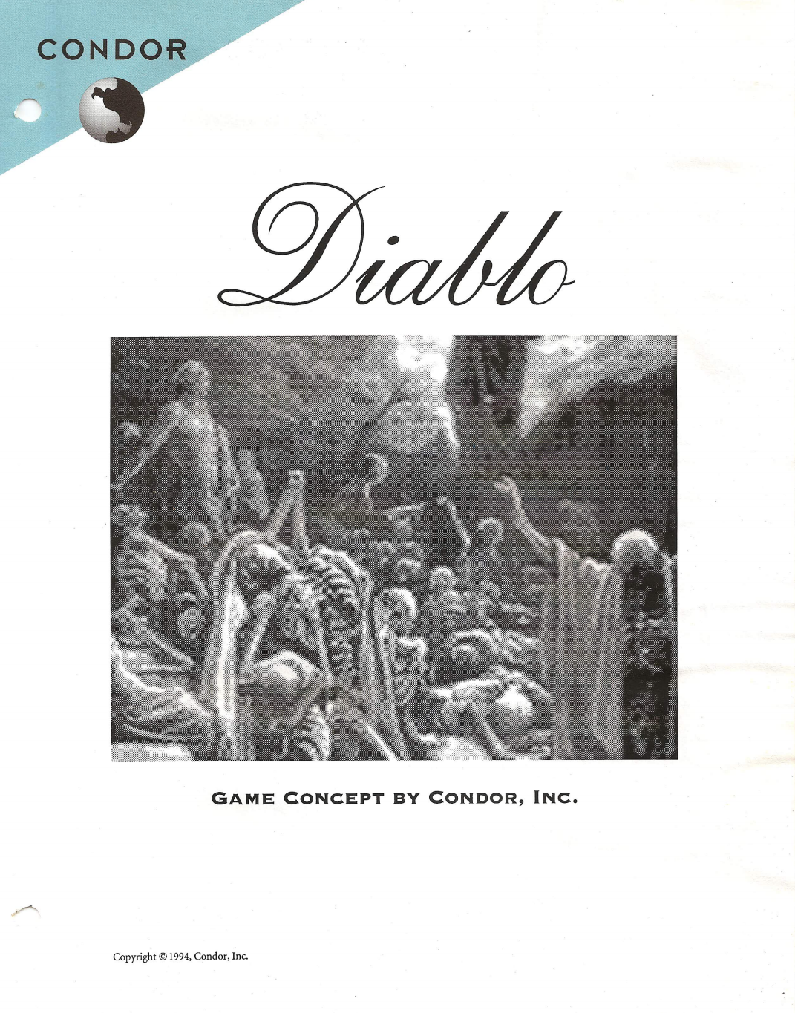

The Pitch Document
This should be around 8-10 pages (including the cover)
Format and theme should echo that of the game – A game with a combat or military theme may a Pitch in the style of classified documents, a fantasy RPG may have the documents resembling parchment.
Some examples:
© Condor, Inc.
© Irrational Games
• Diablo pitch document
http://www.graybeardgames.com/download/diablo_pitch.pdf
• BioShock pitch document
https://www.scribd.com/doc/32211144/Bioshock-Pitch-Document

Slide 9

The Pitch Document
The example here is, again, from ‘Level Up!’ by Scott Rodgers. It must be stressed that this is just one way of doing it. Use it as a guide.
1
The Title Page – The first opportunity to sell our game!
This should have either an image representing the game or a company logo. Preferably both.
Your contact details.
The age range the game is being targeted to.
The target platform or platforms.
Expected shipping date.

Slide 10
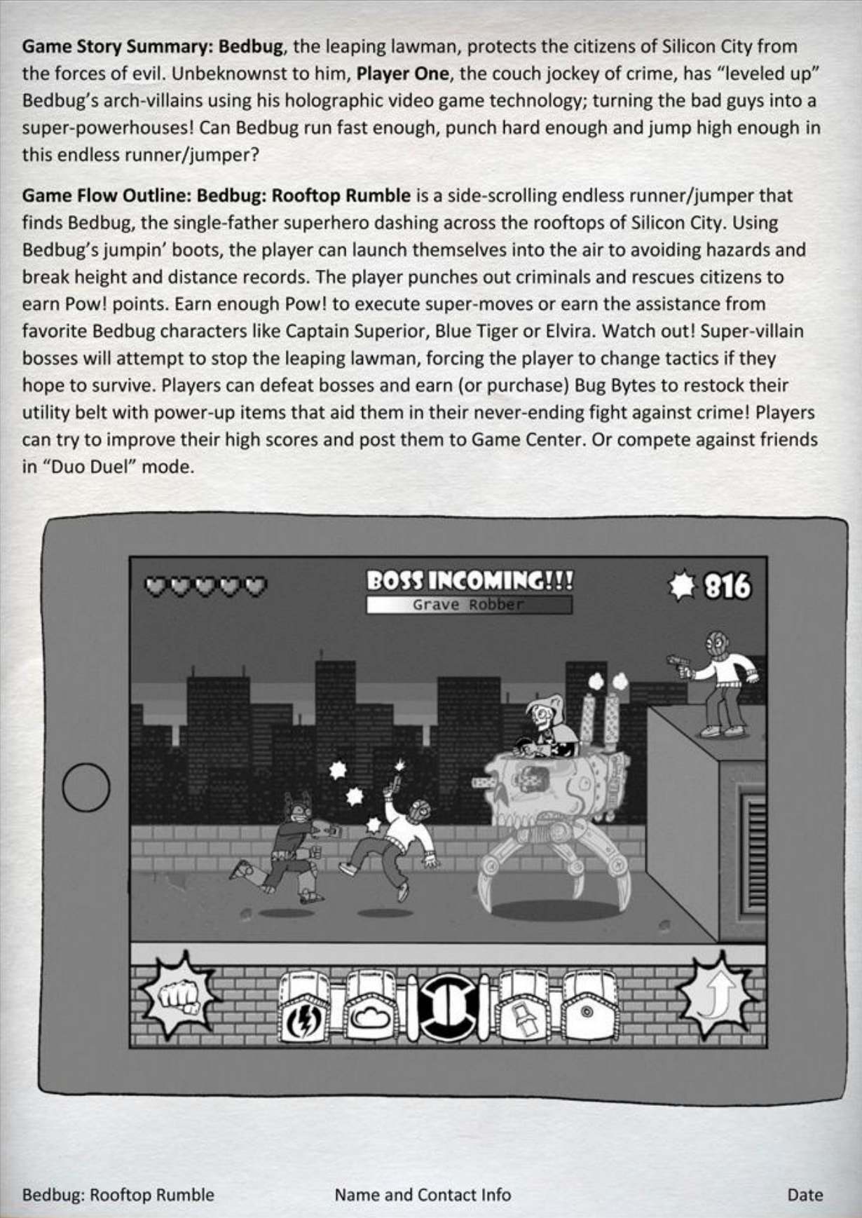
The Pitch Document
2
Game Story Summary and Flow
This is a reiteration of what we wrote in our One-Sheet with a little more polish added.
The Summary is very similar to what we had in our One-Sheet. We can add a little more depth to it, but the real focus is the next part...
Flow- Here we are really describing the experience of playing the game and elements the player can expect to encounter.
We have the introduction of a point scoring system and a 'shop'.

Slide 11
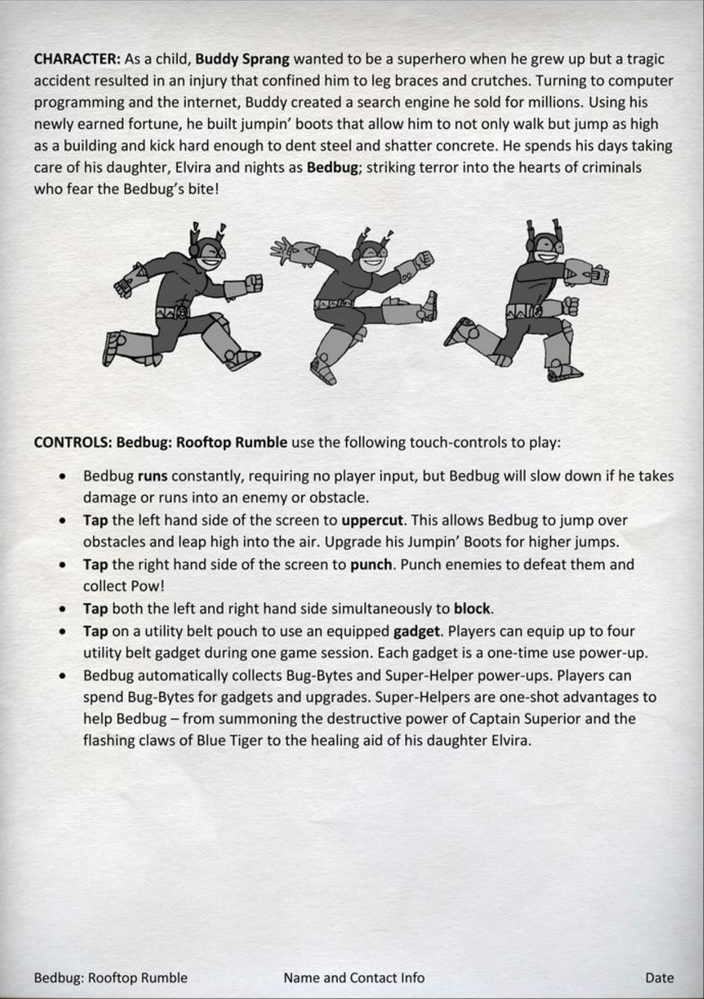
The Pitch Document
3
Character and Controls
A spin on the classic superhero origin story! But our protagonist does not need super- powers to be interesting. What does our character need? Does that drive the narrative?
How we go about our Control section is going to largely depend on what input(s) we use. Are we going for mouse & keyboard, controller? Diagrams will be useful!

Slide 12
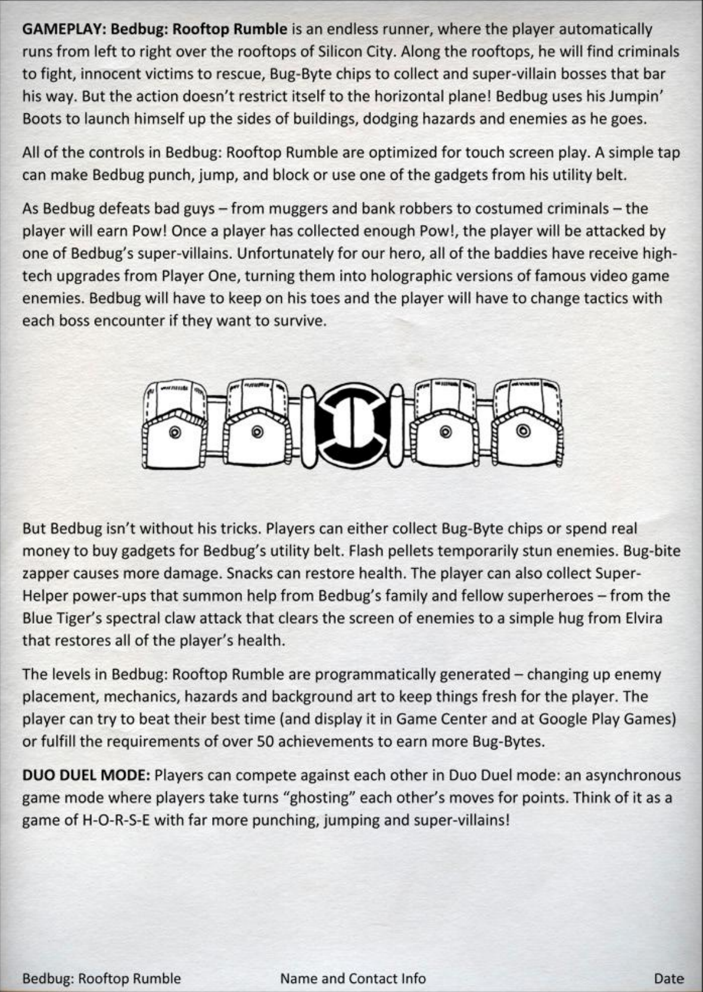
The Pitch Document
4
Gameplay
This may look like a rehash of we saw a couple of slides ago, but there is more emphasis on the detail over the experience.
We are being introduced to different types of bad guy, different types of power-up... These can be expanded upon even more in the full GDD in their own sections.

Slide 13
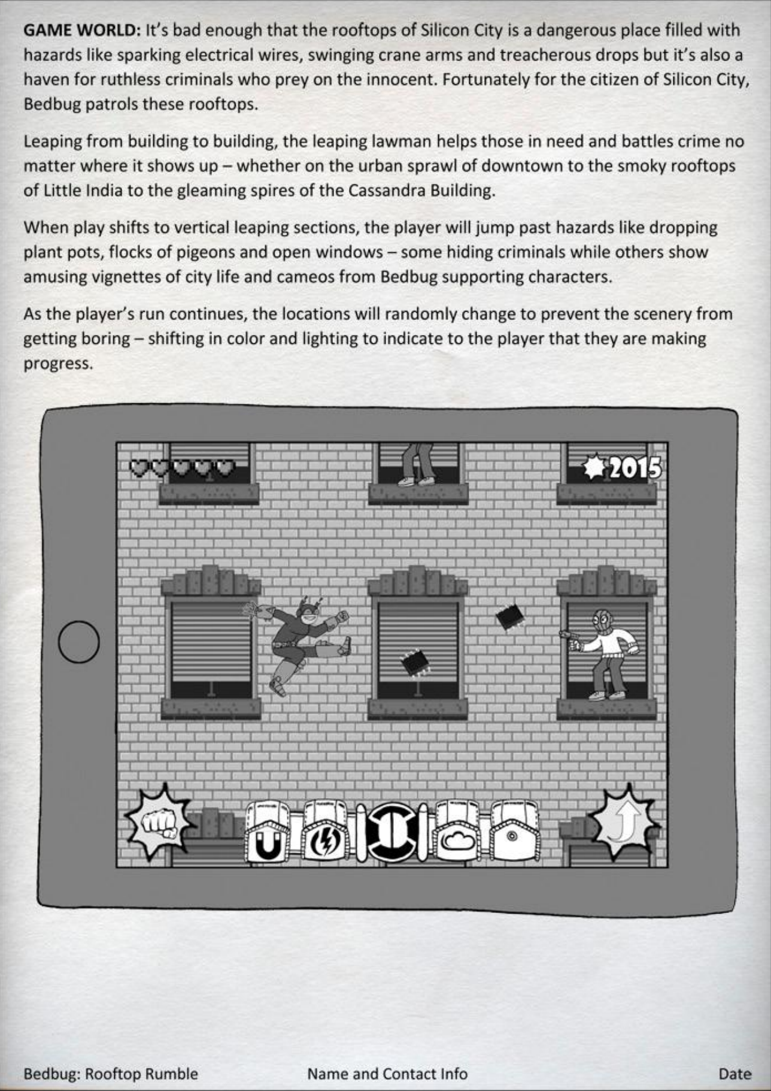
The Pitch Document
5
Game World
We have a lot more about our play experience here. A few more hazards are mentioned (sparking wires, crane arms, plant pots etc)
This section will start to inform the level designer as to what locations will appear in the game.

Slide 14
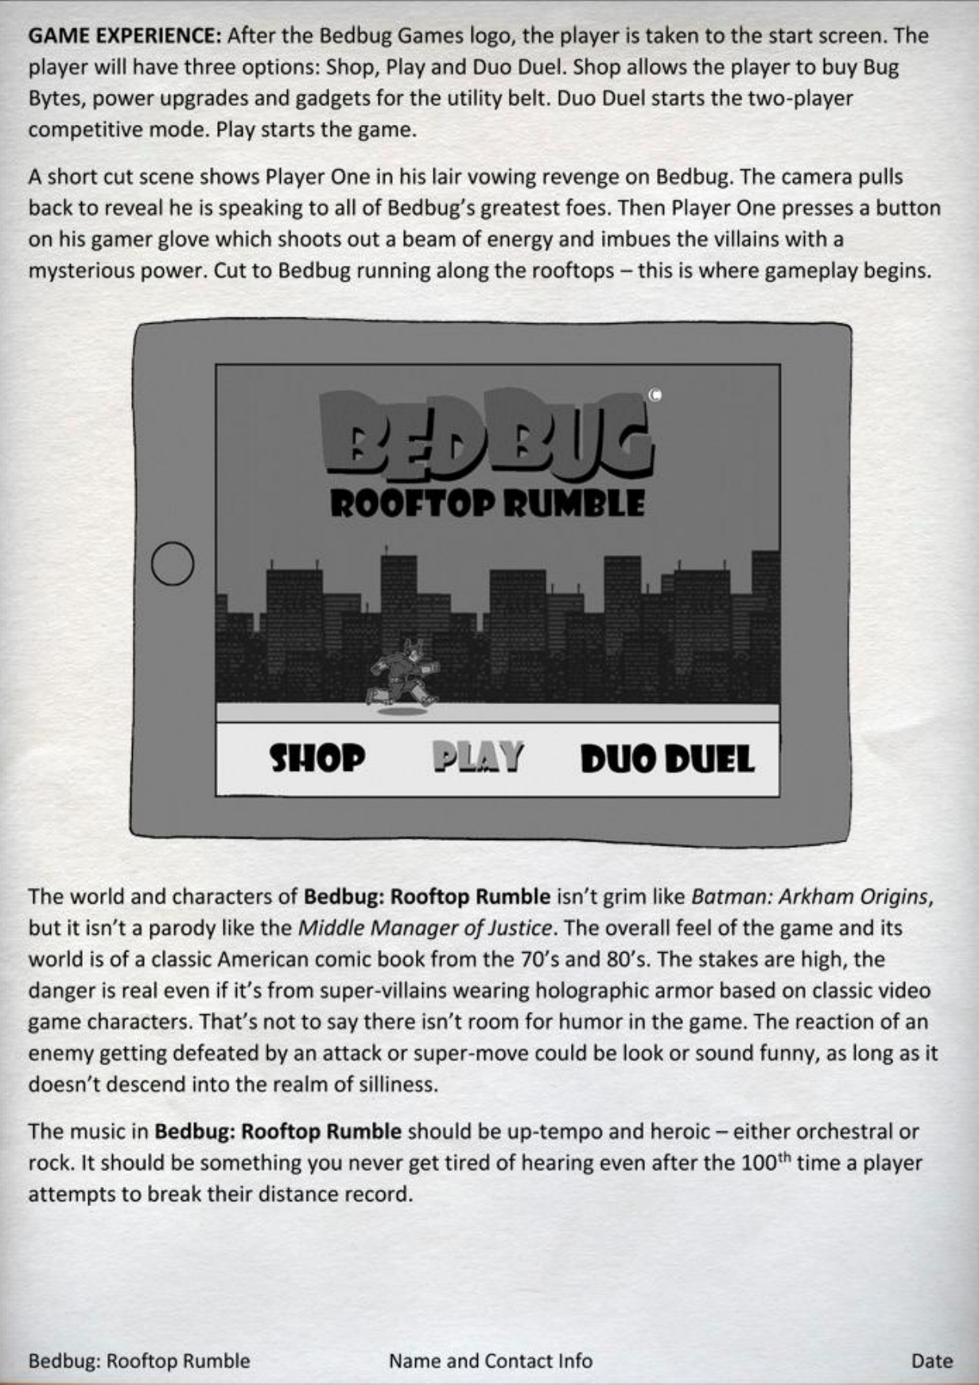
The Pitch Document
6
Game Experience
This page walks us through the experience of firing up the game and navigating through to the start of the game.
The description of the game, the atmosphere and the tone, builds nicely upon the hints we picked up from the from the One-Page.

Slide 15
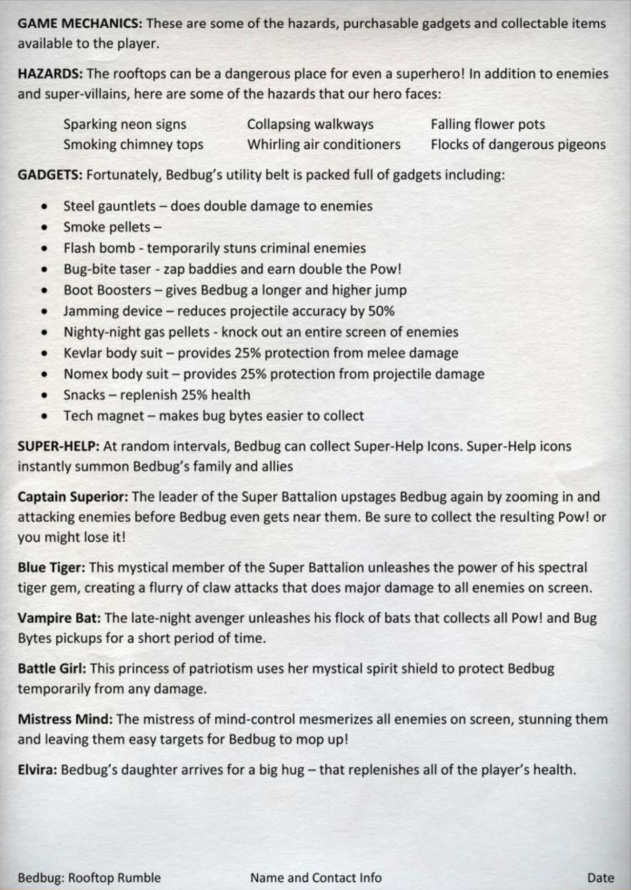
The Pitch Document
7
Game Mechanics
You may have heard this term 'Game Mechanics', and we will explore it further later. Very simply put, they are the ways we interact with the game to achieve objectives.
This page does not introduce anything new, but we have far more information that could be used to create concept art and start a prototype.

Slide 16
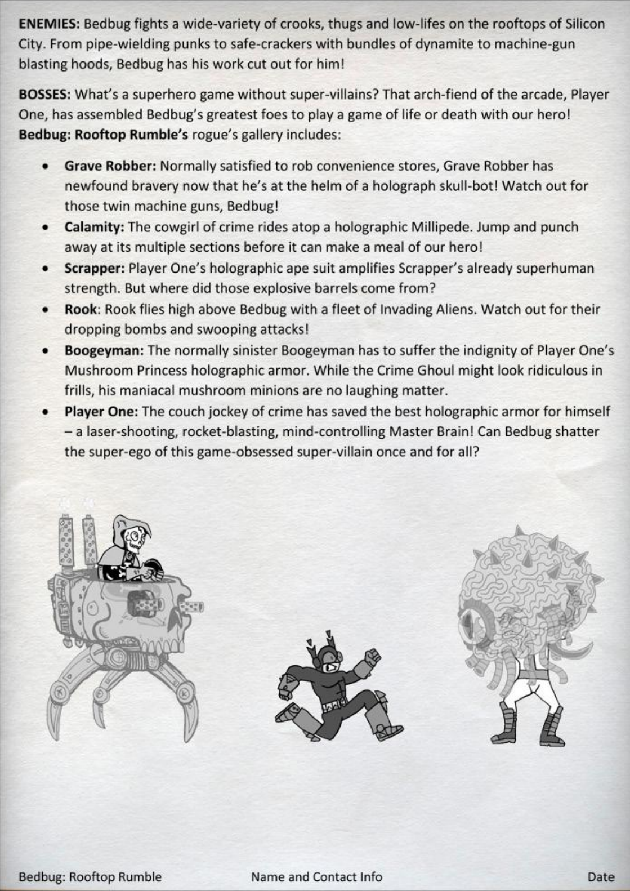
The Pitch Document
8
Enemies & Bosses
Who or what is our protagonist up against?
On this page we can dive deeper into the various rogues we will encounter. Do we have End-Of-Level Bosses? If so, what threat do they pose? What special weapons or abilities will challenge us?

Slide 17
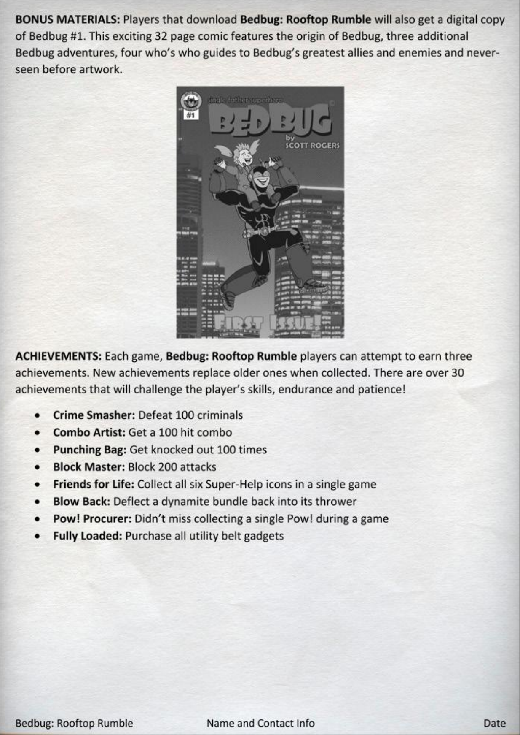
The Pitch Document
9
Bonus Content and Achievements
Does anything ship with the game, bonus content? Will there be DLC? A soundtrack?
Is there anything for the player to unlock through playing the game? Steam, XBox and PlayStation all have their variations on badges and awards to display on your profile. How will your game reward the completists out there?

Slide 18
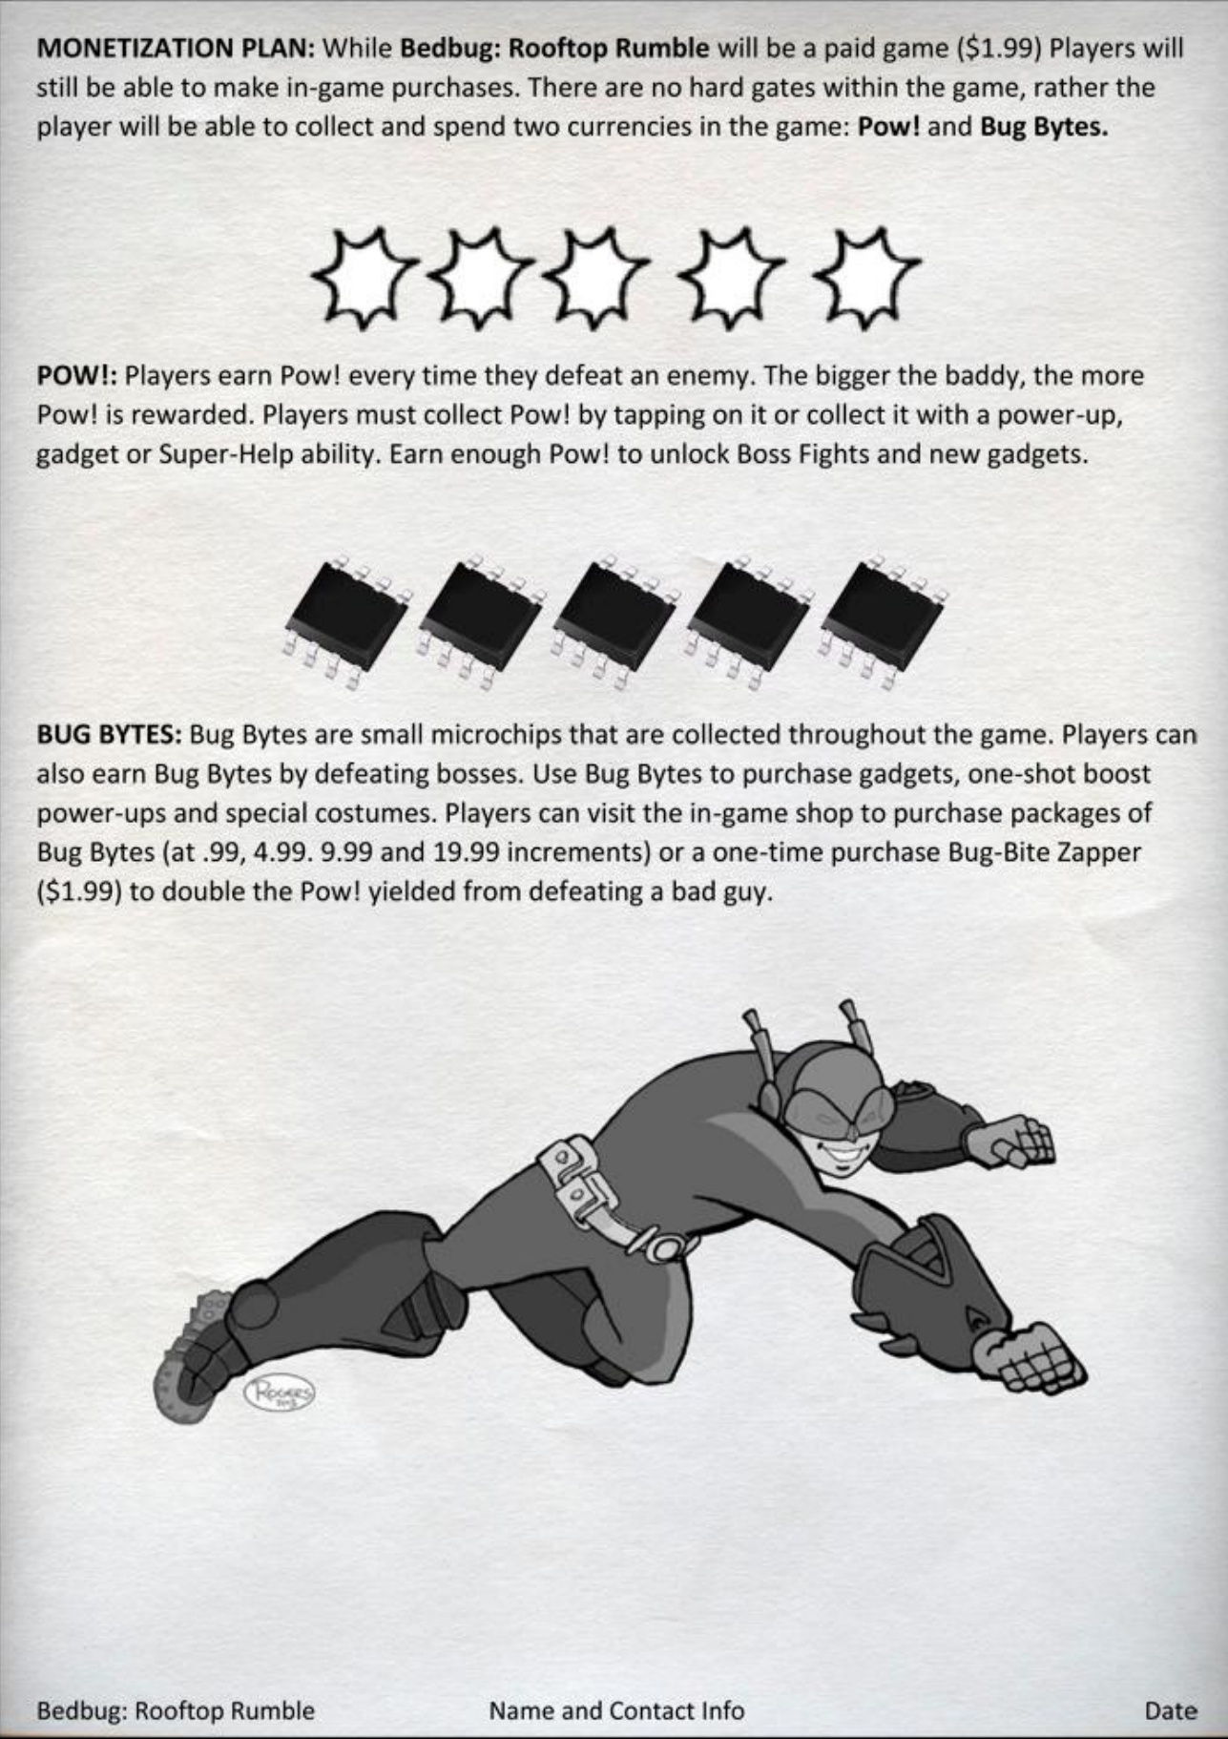
The Pitch Document
10
Pricing & Monetisation
How much will our game cost? Will there be different versions at different price points?
Does the game utilise microtransactions or paid DLC? Are there any paid content such as different costumes or will in-game currency be exchanged for real-world currency?

Slide 19
Your go…
You have already made a start on some documentation as part of your Explore module last term. We are now going to begin formalise that into a GDD, working our way up from:
The One-Page
Ten-Page
Full GDD (which will be your WRIT1 submission).
IMPORTANT – Do not leave starting the PRAC1 until after the deadline for the WRIT1. You should have capacity within your team to manage both concurrently.
VERY IMPORTANT – This is an academic piece of work. Any statements or claims to knowledge must be supported by good evidence. Citations and references in Havard style will be expected. Make sure you are not writing in first-person.
If you need advice on this, please ask as we go.

